Slide 1
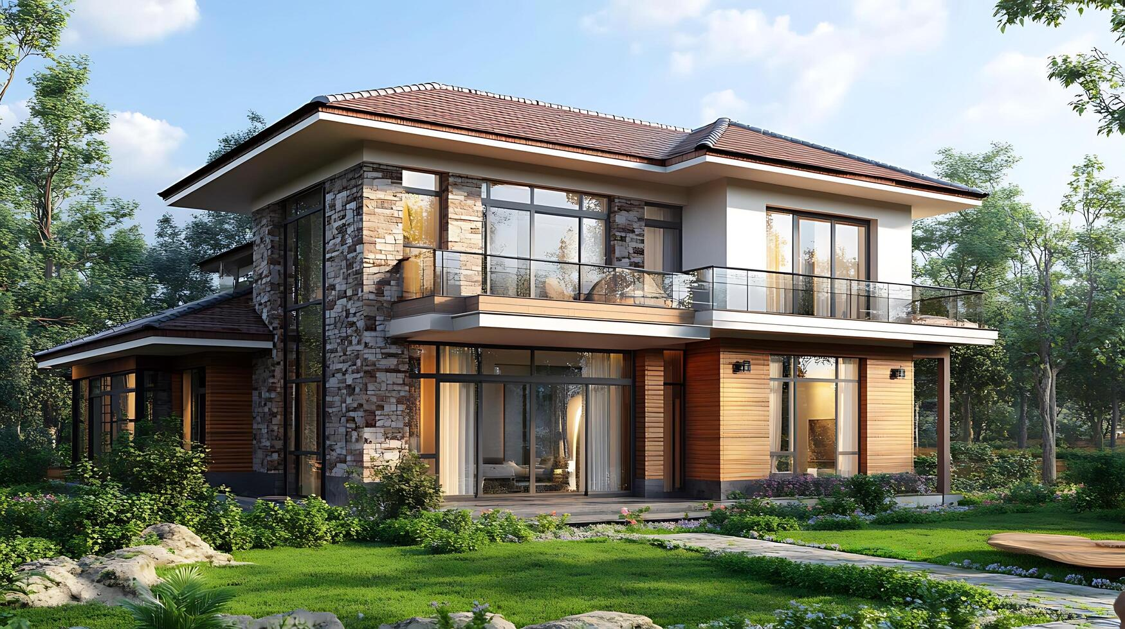
Apne sapno ka ghar
ARCHITECH
Prévision
Hegfr grng hkjeg .dm,fgskej.,dtrbmnhglks.rj,mbvgvmse,dr
Hthkltrsnhskr jxdbgaernzsg;rkaej,gbwesfhgjbsondrmjhg
Vdknbkldr releh 5krsg serl; hea5,n ael g 4engh atyae4kjtbn;w4oahte4mtejkbthgnelkfjghbvkjcvbn er;khgf erkgnkjgfjbaew’pgrjtr;ljhnrgk,r ab.,, rdoesndglkatk ksfjkerlglergergenikgergerw tleizstkl

Slide 2
Apne sapno ka ghar
ARCHITECH
Prévision
Problem
Architects and homeowners struggle with visualizing and planning house layouts, leading to inefficiencies in time, cost, and design accuracy.
Solution
Utilizes AI to generate accurate 2D house maps.
Provides architects with a quick and efficient design foundation.
Reduces time and costs associated with manual planning.
Enhances visualization for both architects and homeowners.
SERVICES

Slide 3
Problem
Architects and homeowners struggle with visualizing and planning house layouts, leading to inefficiencies in time, cost, and design accuracy.
Solution
Utilizes AI to generate accurate 3D and 2D house maps.
Provides architects with a quick and efficient design foundation.
Reduces time and costs associated with manual planning.
Enhances visualization for both architects and homeowners.
SERVICES

Slide 4
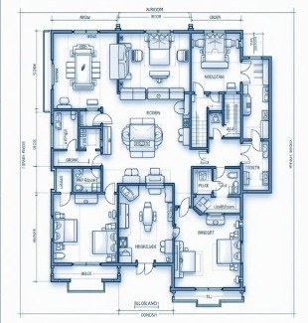
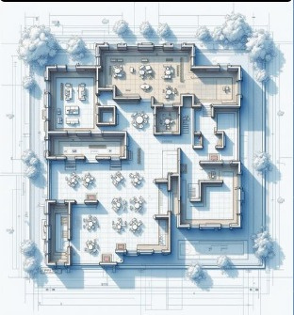
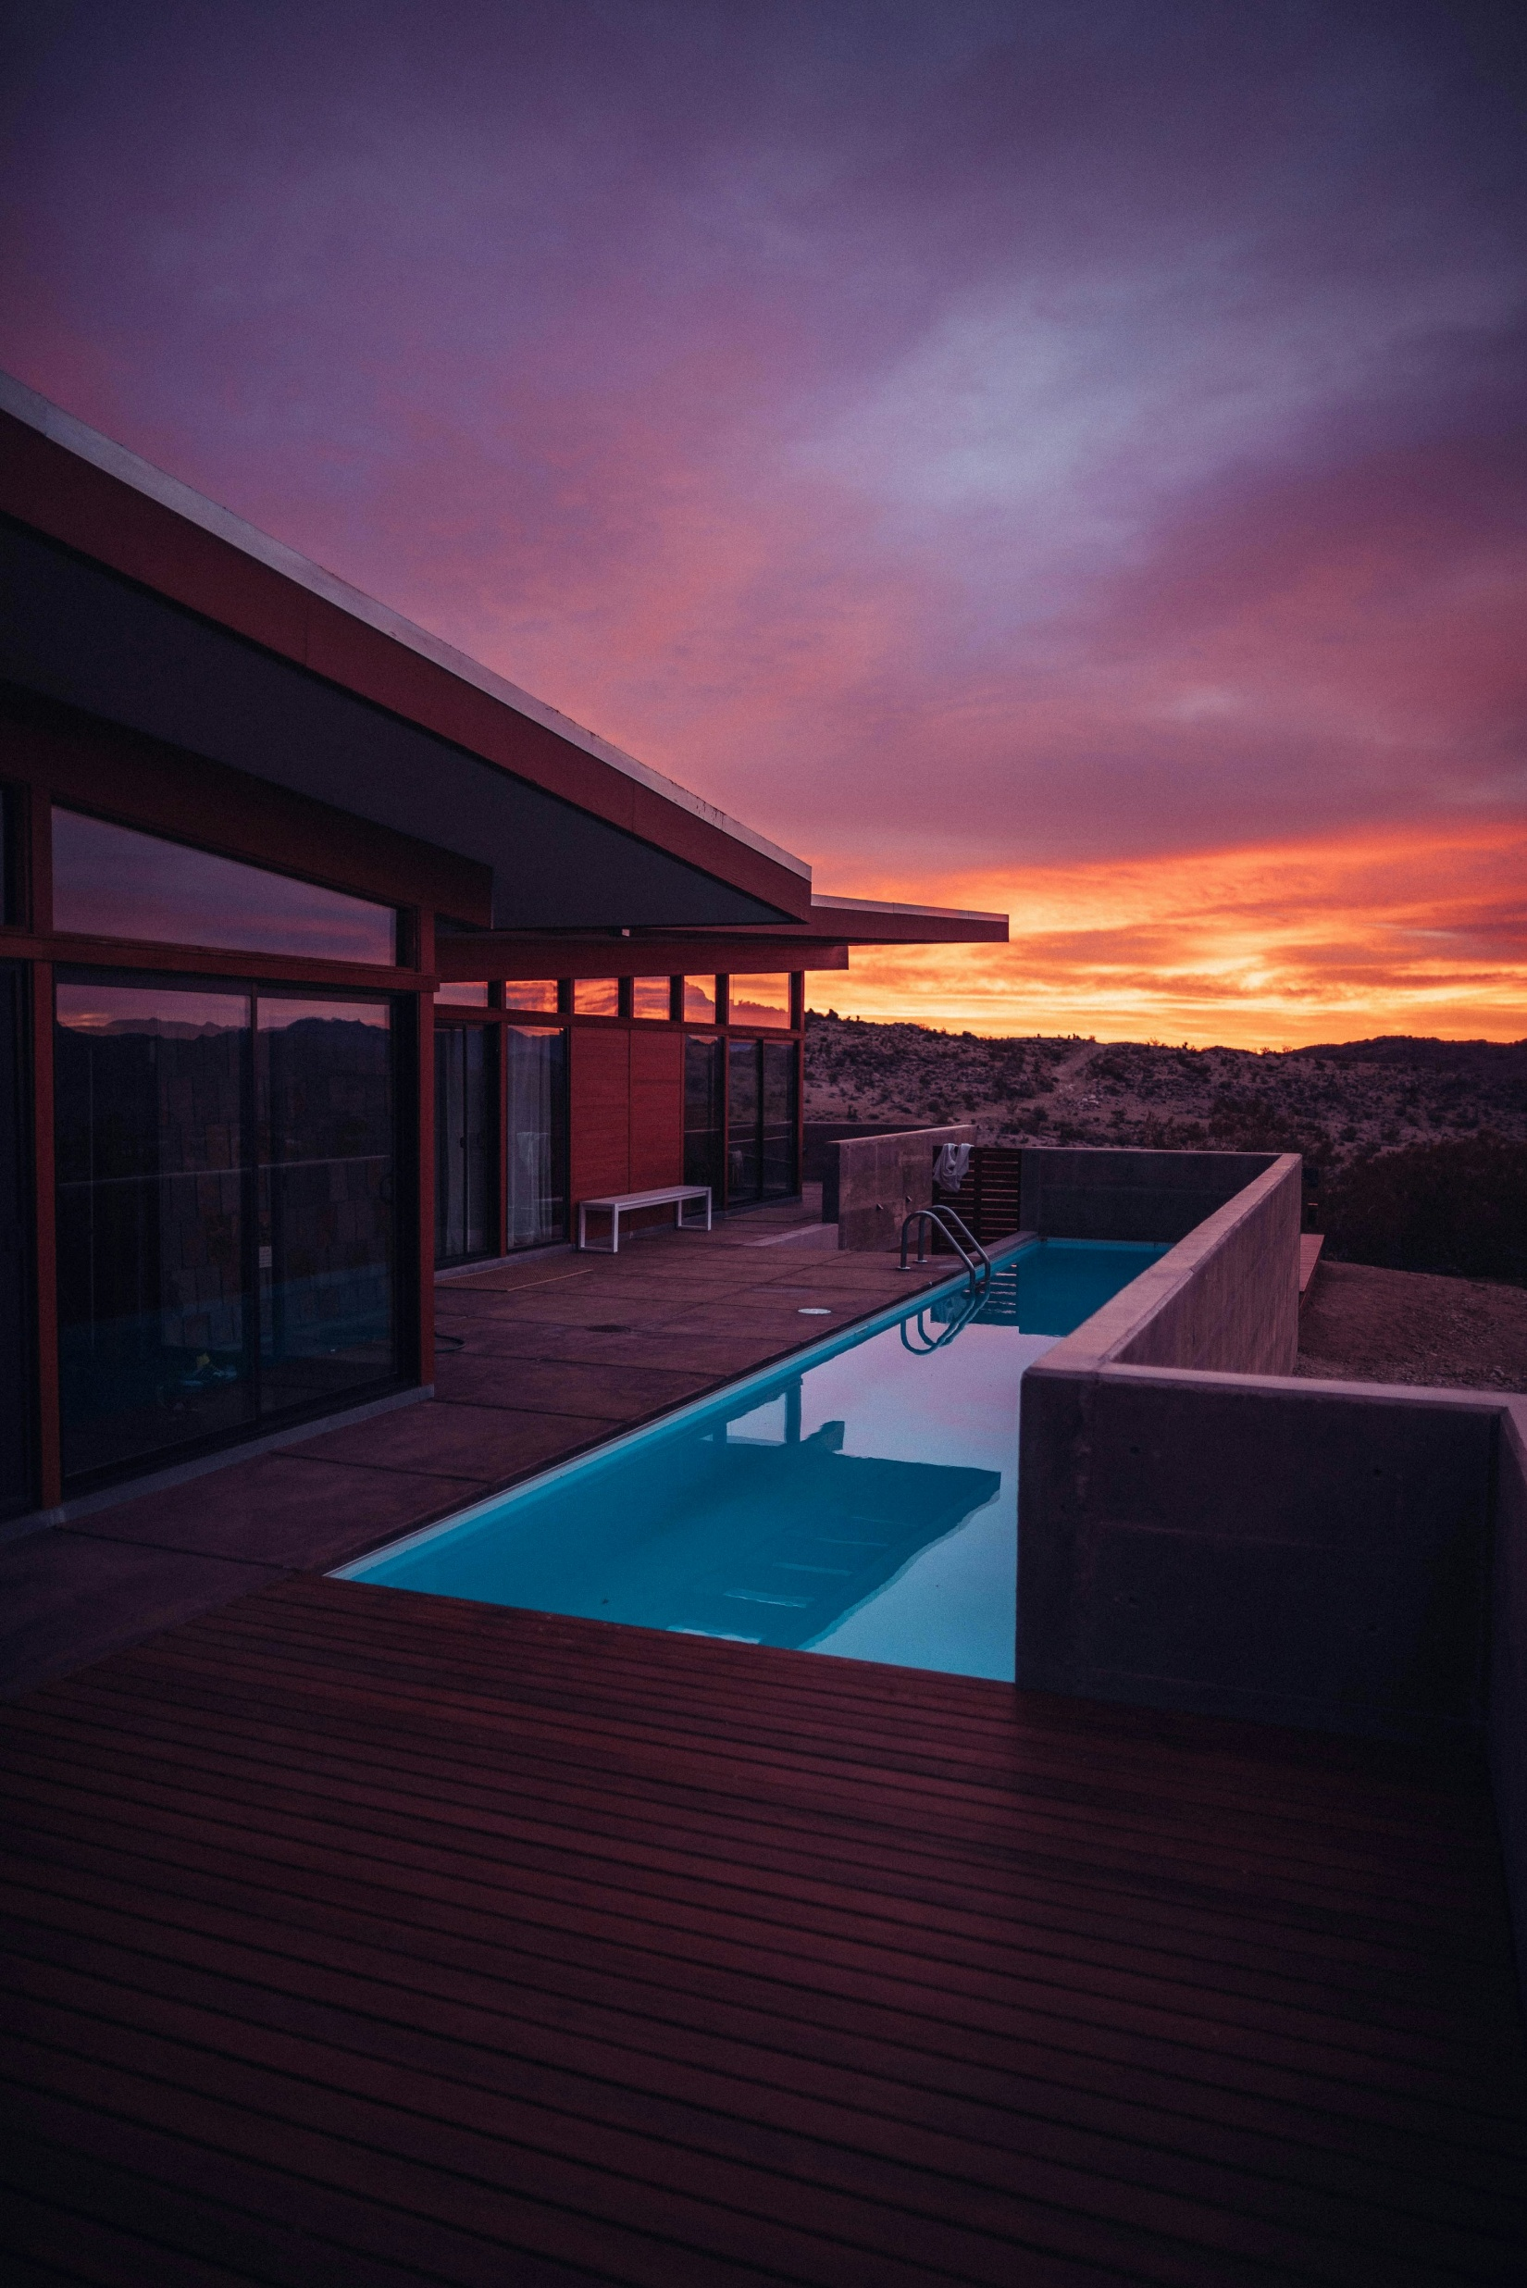
LUXURY
Villa
Standard
Studio

Slide 5

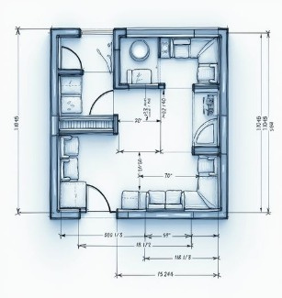
LUXURY
Villa
Subscription
model
Standard
Studio
Business
model

Slide 6
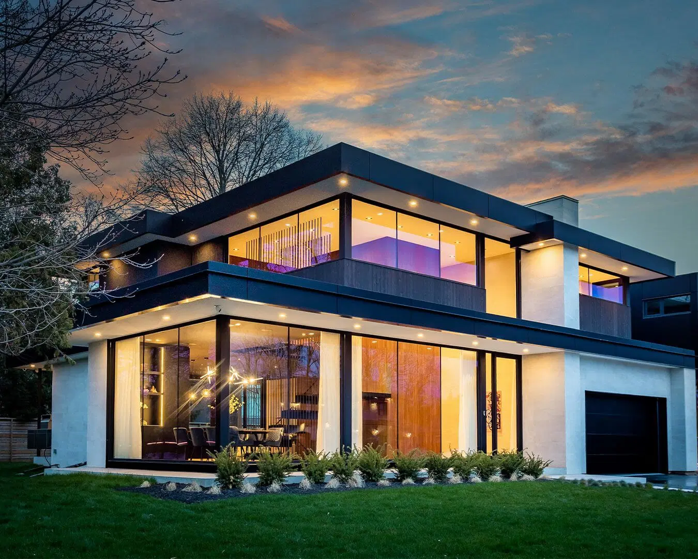
Standard
Studio
Subscription
model
Individual use
Starter Plan
(For Homeowners & DIY Planners)
₹999/month
AI-generated 2D layouts
5 free renders per month
Basic customization (room sizes, doors/windows)
High-resolution design downloads
Pro Plan
(For Architects & Interior Designers)
₹6,999/month
Everything in Starter Plan
Unlimited renders
AI-driven space optimization
Export to CAD & Revit
Collaboration tools for design teams

Slide 7
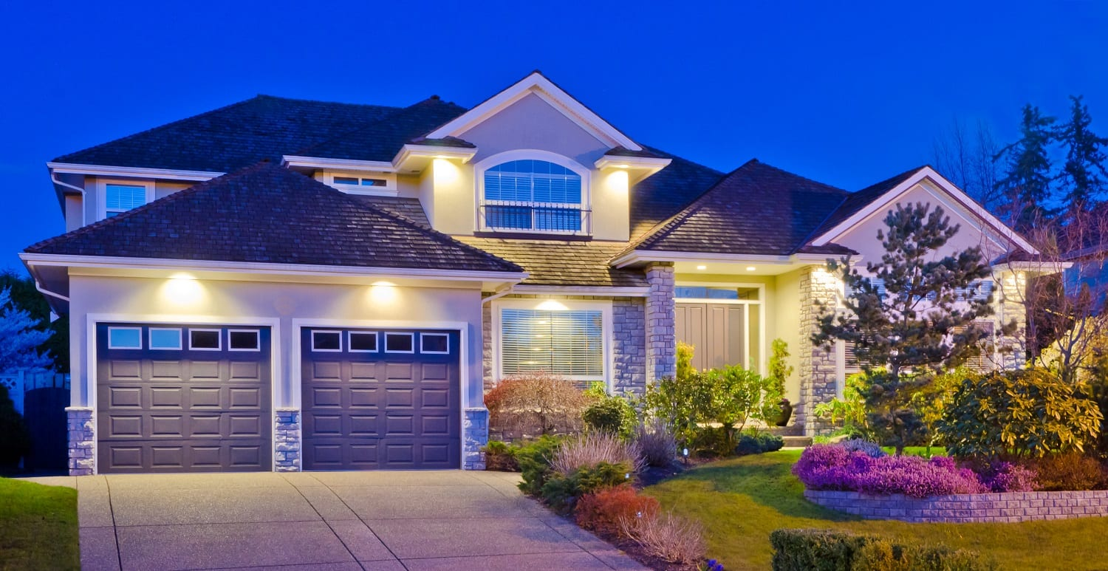
Subscription
model
Individual use
professional use
Starter Plan
(For Homeowners & DIY Planners)
₹999/month
AI-generated 2D layouts
5 free renders per month
Basic customization (room sizes, doors/windows)
High-resolution design downloads
Pro Plan
(For Architects & Interior Designers)
₹6,999/month
Everything in Starter Plan
Unlimited renders
AI-driven space optimization
Export to CAD & Revit
Collaboration tools for design teams
Business Plan
(For Real Estate Developers & Brokers)
₹9,999/month
Everything in Pro Plan
Unlimited 2D renders
AI-driven space optimization
Export to CAD & Revit
Collaboration tools for design teams
Verified Plan
(For Legal & Compliance Needs)
₹29,999/month
Everything in Business Plan
Broker-verified layouts to match market trends
Government-approved designs following safety & legal norms
Ideal for permits, legal approvals & large-scale projects

Slide 8
Market size
Individual use
professional use
Starter Plan
(For Homeowners & DIY Planners)
₹999/month
AI-generated 2D layouts
5 free renders per month
Basic customization (room sizes, doors/windows)
High-resolution design downloads
Pro Plan
(For Architects & Interior Designers)
₹6,999/month
Everything in Starter Plan
Unlimited renders
AI-driven space optimization
Export to CAD & Revit
Collaboration tools for design teams
Business Plan
(For Real Estate Developers & Brokers)
₹9,999/month
Everything in Pro Plan
Unlimited 2D renders
AI-driven space optimization
Export to CAD & Revit
Collaboration tools for design teams
Verified Plan
(For Legal & Compliance Needs)
₹29,999/month
Everything in Business Plan
Broker-verified layouts to match market trends
Government-approved designs following safety & legal norms
Ideal for permits, legal approvals & large-scale projects

Slide 9
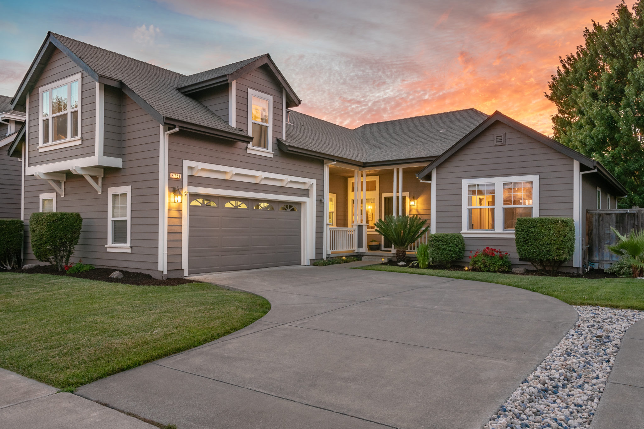
professional use
Monthly Expense
AWS – Rs. 9000 (Cloud Hosting )
Model Cost – Rs. 1500
MySQL – Rs. 1200 ( Database )
Domain And SSL – Rs. 125
Payment Gateway – 2% of transaction
GST Number – Rs. 8000
Total Cost – Rs. 20500

